Slide 1

Our app: A Library of Programming books
A presentation by Dummies

Slide 2
What our app does
Accepts an admins user password
Able to add new books to the database
Prompts for title, language, author, publisher
Able to list all the stored books
Able to search for the books in database using simple strings
Able to read out as speech most prompts and most outputs (hopefully)

Slide 3
The Chocolate chips in the vanilla ice cream
TTS (text to speech)
Limitations
Your user will need tts and mpg123
Needs internet connection - at least for dynamic playback- can save as mp3
Possibility for impatience with read out - touching buttons can break app during readout
The good things
Very good way to improve accessibility of your app
Extremely easy to implement
Great for a laugh or to annoy your classmates
TTS=Extremely groovy gem

Slide 4

TTS a quick install guide and user guide
In CLI
sudo apt-get install mpg123
gem install tts
gem update
Using TTS in CLI
tts “Hello class prepare to die”
Using tts in VS ruby files:

Slide 5
What we would like our app to do in the future
Extend the functionality of the TTS (text to speech) gem to read more than just prompts and outputs i.e. read a book
Have our data saved as JSON or other method of using data storage
Include prices on books and been able to search through a range based on prices
Create a way to search off more than one keyword
Ability to checkout or sell books
Bring app into a GUI environment - RAILS

Slide 6
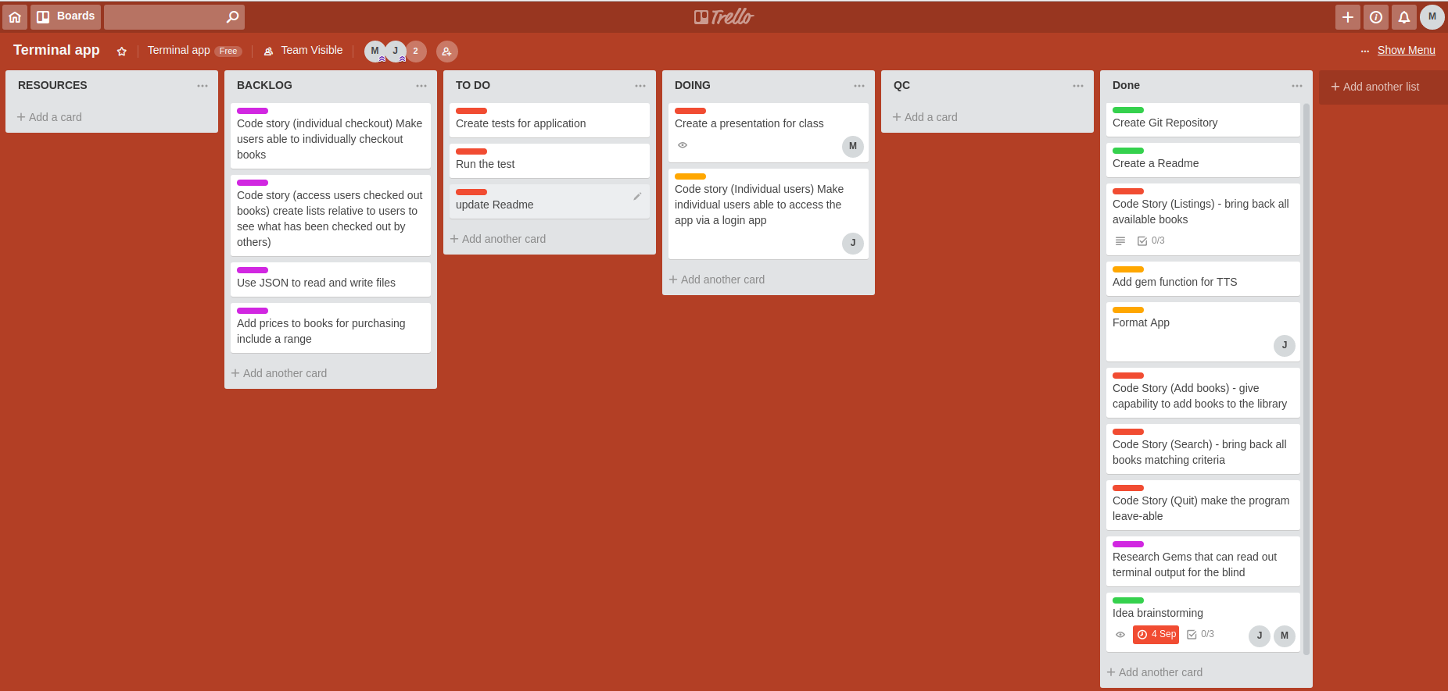
Planning, iteration and all round agile
Trello was used-It worked well- not needed for a project this size but good practice

Slide 7
Testing
Small test suite to begin-not built for what we ended up with
TDD not followed
What we found hard about TDD
Need to have a very good idea of what your app will look like and how it will be structured
Easy to assess basic attr_acessors - harder for hashes and arrays
Highlights the need for more learning in this area

Slide 8
What our app does well
Other approach user or developer stores data as a hash or an array which code retrieves
Our route takes formatted string data from a text file that we can apply a search too and retrieve specific lines
If there is no Text file available our application will create a blank one which can be added too from the app

Slide 9
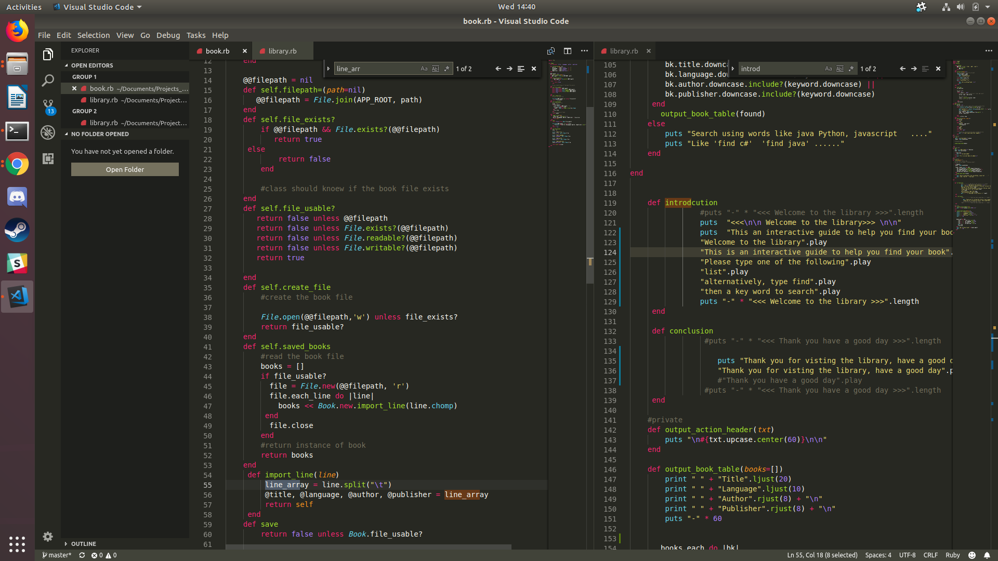
Getting our app to create a file to reference

Slide 10
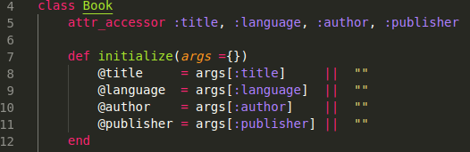
How our app then reads and writes to that file
Attribute accessor that is able to accept arguments from a user and does not require an order
We’ll probs just show you the code

